Slide 1
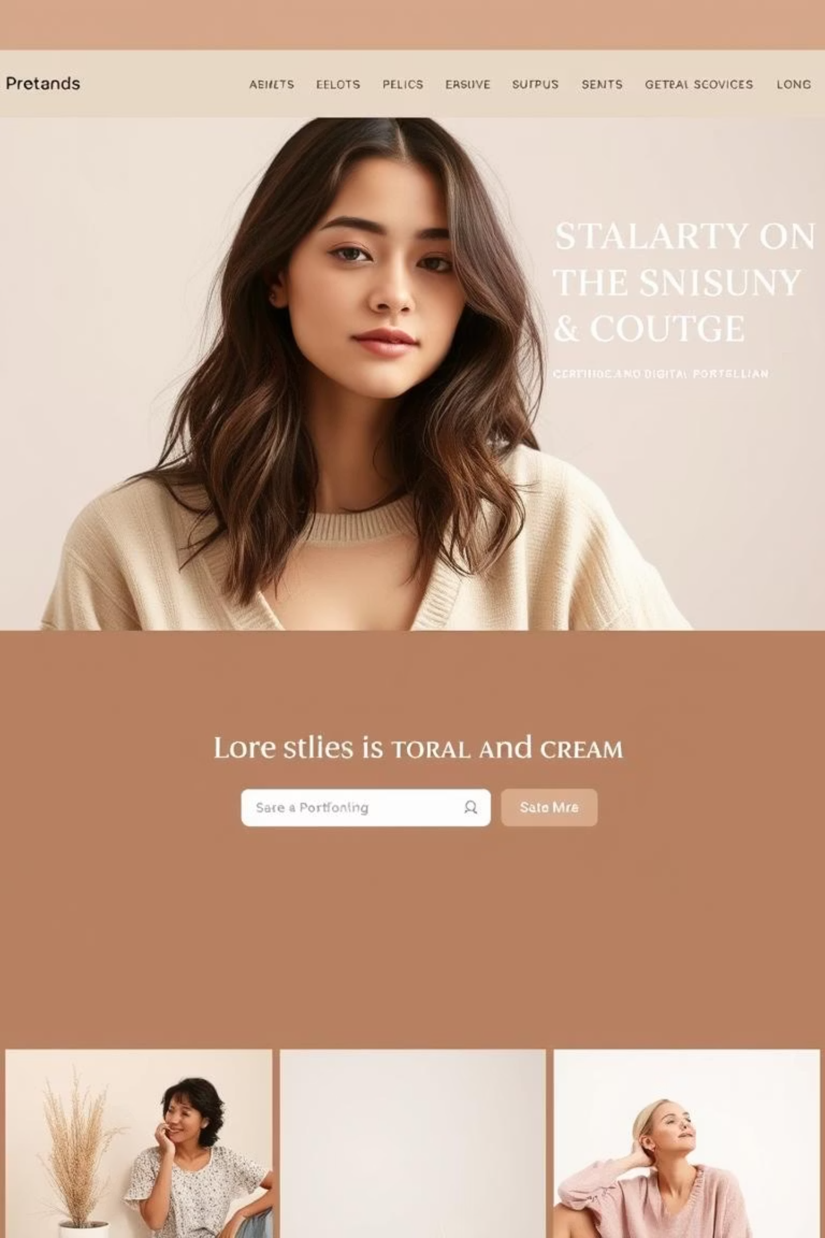
Crafting Digital Narratives: My Portfolio Showcase
Presented by SHEEBA KOWNAIN. S
Register No: 34624U09088 / NMID: astvu346m24393
Department: Bachelor of Computer Application
College/University: M.M.E.S. Arts and Science College / Thiruvallur University

Slide 2

The Challenge: Bridging Talent & Opportunity
In today's competitive landscape, showcasing skills and projects effectively is paramount. The absence of a dedicated, dynamic platform can often hinder a professional's ability to stand out and connect with potential employers or collaborators.
Many aspiring professionals, especially in the tech domain, struggle to present their diverse skill sets and practical experiences in a cohesive and accessible manner. Traditional resumes, while essential, often lack the visual and interactive elements needed to convey the depth and breadth of one's work.
This digital portfolio aims to address this challenge by providing a centralised, visually engaging, and easily navigable platform for presenting academic projects, technical proficiencies, and personal contributions.

Slide 3
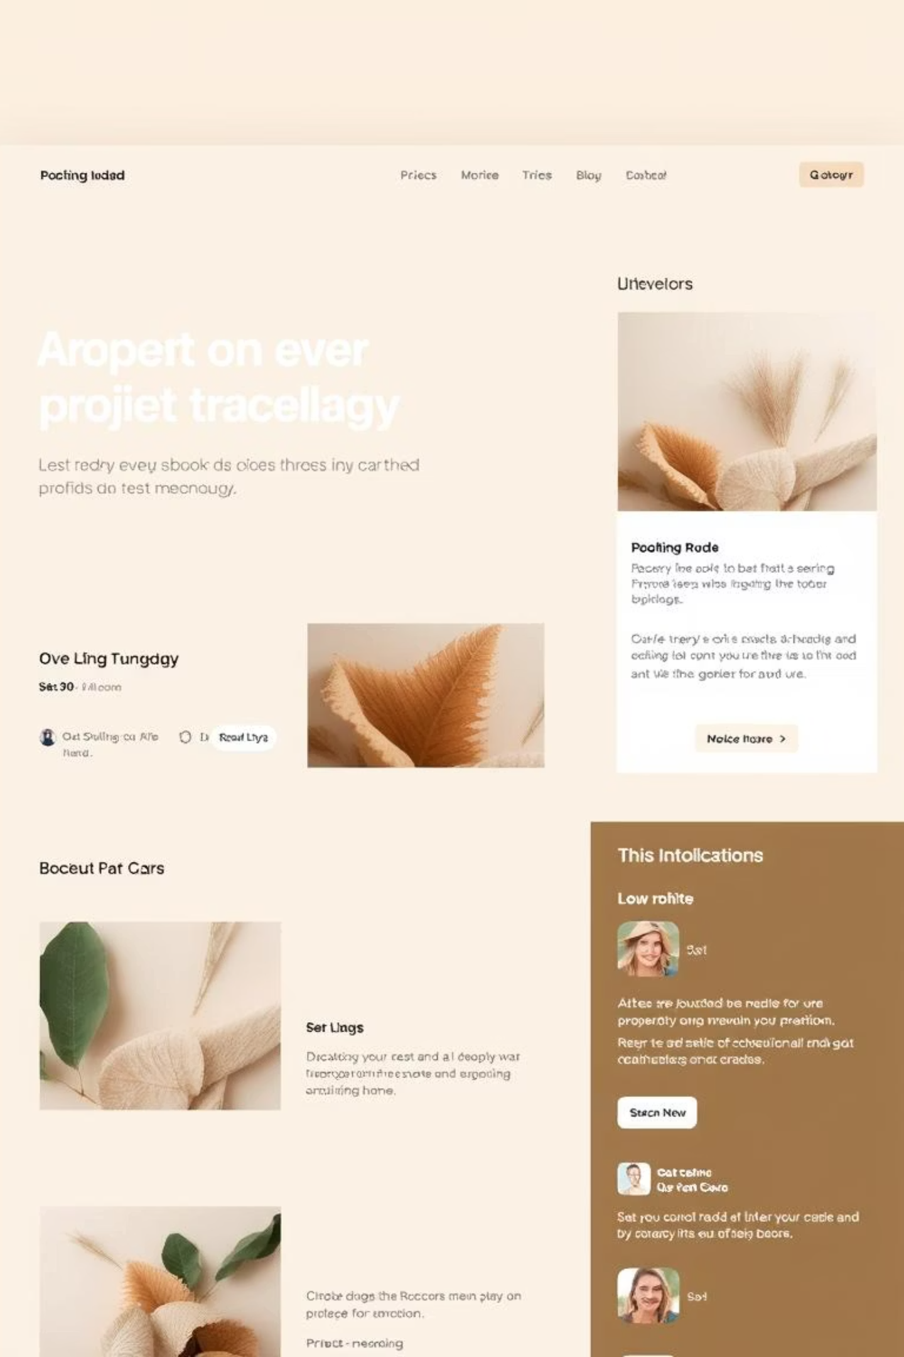
Project Overview: A Digital Identity
This digital portfolio serves as a comprehensive online representation of my academic journey, technical expertise, and project accomplishments. It is designed to offer a dynamic and interactive experience for visitors, allowing them to explore my capabilities and understand my professional aspirations.
01
Showcase Skills
Highlighting programming languages, frameworks, and tools acquired through academic courses and self-learning.
02
Display Projects
Presenting detailed descriptions, functionalities, and learnings from key academic and personal projects.
03
Personal Branding
Establishing a professional online presence that reflects my dedication and unique approach to problem-solving.
04
Accessibility
Ensuring easy access to my work and contact information for prospective recruiters and collaborators.

Slide 4





Who Benefits? Our Key Audiences
The digital portfolio is meticulously crafted to cater to several important end-user groups, ensuring maximum impact and reach for my professional journey.
Recruiters & Hiring Managers
Future Collaborators
Seeking qualified candidates for technical roles, evaluating practical skills and project experience efficiently.
Individuals or teams looking for project partners with complementary skills and a demonstrated portfolio.
Potential Clients
Fellow Students & Academia
For freelance opportunities, looking for tangible proof of work and technical capabilities before engagement.
A resource for inspiration, learning, and understanding diverse approaches to computer application projects.

Slide 5

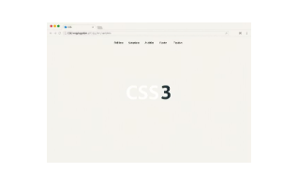
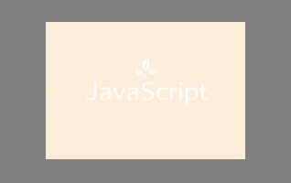
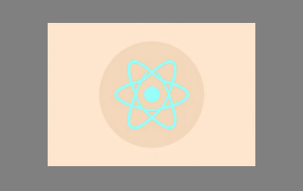


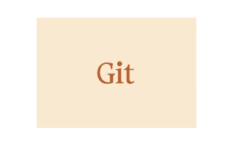





Arsenal of Innovation: Tools & Technologies
The digital portfolio has been developed using a robust stack of modern tools and technologies, ensuring its functionality, responsiveness, and aesthetic appeal. Each tool was chosen for its efficiency and industry relevance.
Frontend Development
Backend & Database
HTML5, CSS3, JavaScript, React.js for interactive user interfaces.
Node.js for server-side logic and MongoDB for flexible data storage.
Version Control
Development Tools
Git for collaborative development and efficient code management.
VS Code as the primary IDE for a streamlined coding experience.

Slide 6
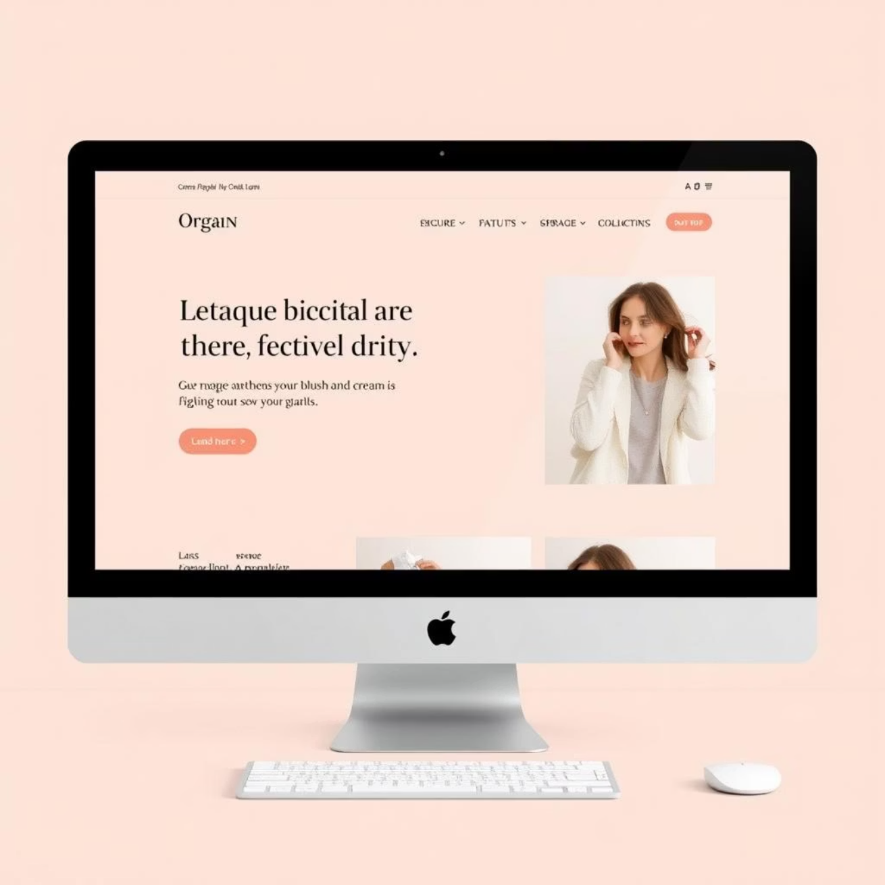
Aesthetic & Intuitive: Portfolio Design Principles
The design and layout of this digital portfolio are centered around key principles to ensure an impactful and user-friendly experience. A clean, modern aesthetic is combined with intuitive navigation to allow visitors to effortlessly explore content.
User-Centric Navigation
Responsive Across Devices
Clear menus and logical flow to easily find projects and information.
Optimised for seamless viewing on desktops, tablets, and mobile phones.
Clean & Modern Aesthetic
Minimalist design, balanced typography, and a cohesive colour palette.
The visual appeal is enhanced by strategic use of white space and a harmonious colour scheme, including touches of #835E54 for emphasis, creating a professional and inviting environment.

Slide 7
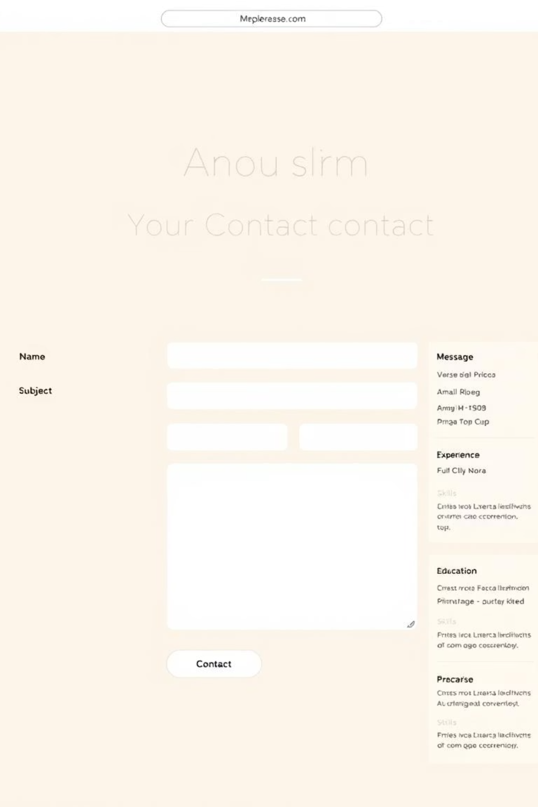



Dynamic Functionality: Key Features
Beyond static information, the portfolio integrates several dynamic features and functionalities, making it an interactive and valuable resource for visitors.
Interactive Project Display
Downloadable Resume
Detailed project pages with descriptions, tech stacks, and links to live demos or GitHub repositories.
A dedicated section to view and download my updated resume in a professional format.
Direct Contact Form
An easy-to-use form for inquiries, collaborations, or job opportunities.
These functionalities ensure that visitors can not only learn about my work but also easily connect with me for further engagement. Each feature is designed with the user in mind, prioritising accessibility and efficiency.

Slide 8
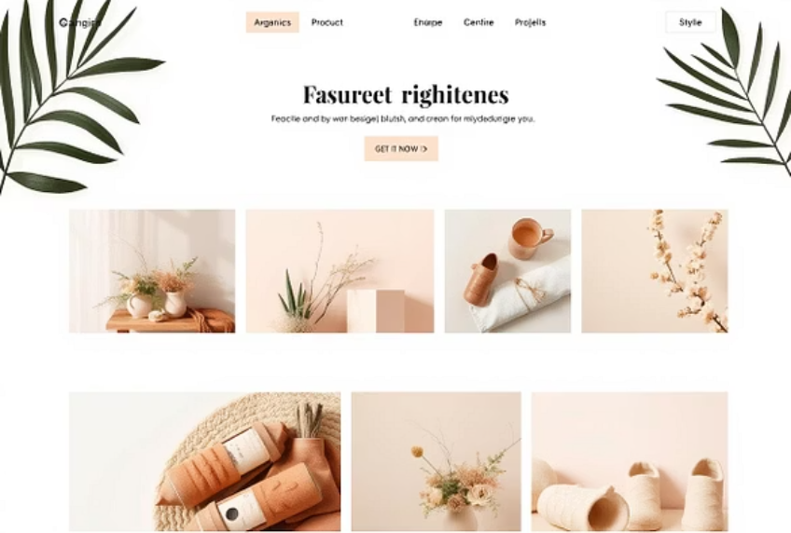
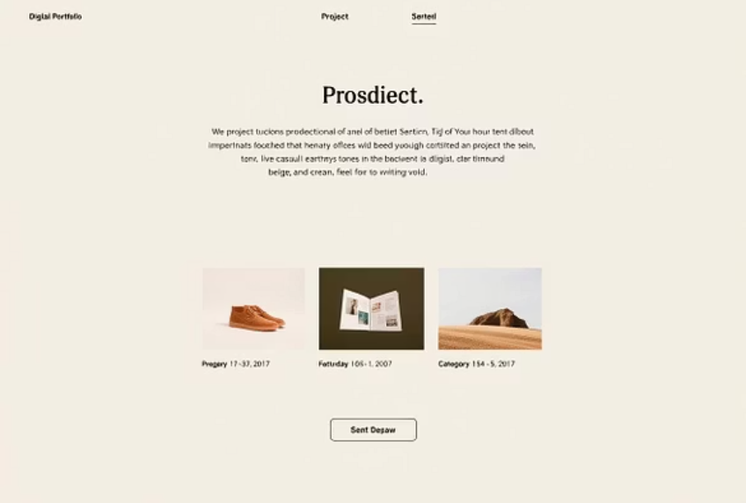
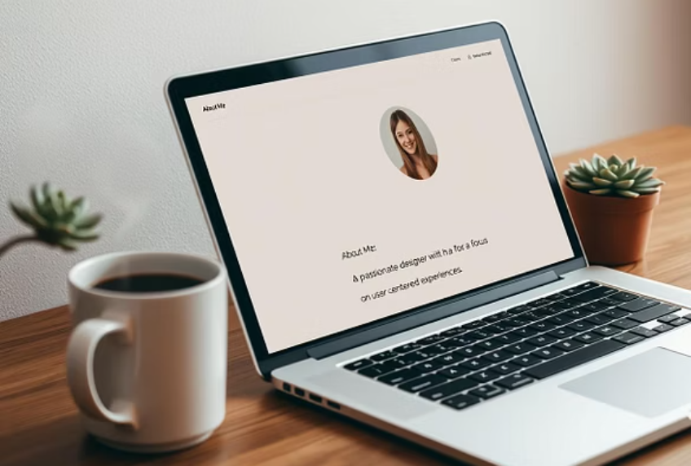
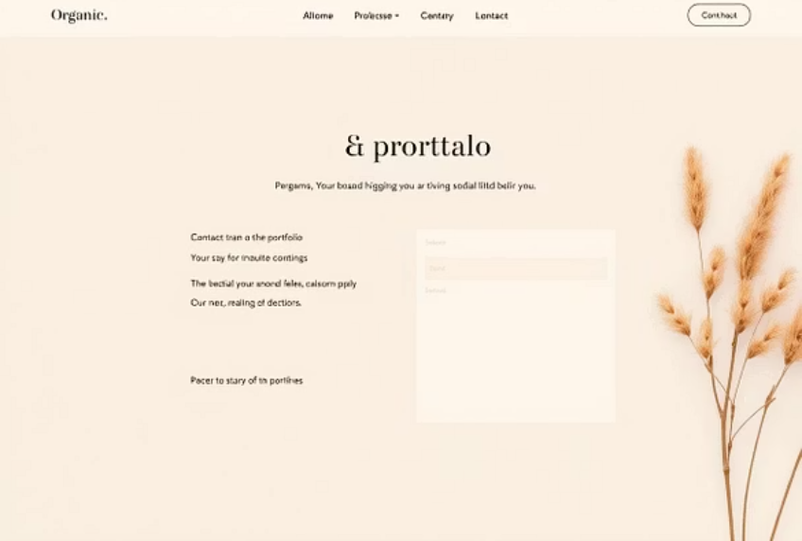

Impact & Interface: Results and Screenshots
The culmination of this project is a fully functional and visually appealing digital portfolio, ready to make a significant impact. Here are some glimpses of its interface and design, showcasing its responsiveness and content presentation.
These screenshots illustrate the clean layout, clear typography, and effective organisation of content, ensuring that my skills and projects are presented in the best possible light across various devices. The user interface focuses on simplicity and user experience.

Slide 9


Conclusion: My Digital Footprint
This digital portfolio is more than just a collection of projects; it is a testament to my dedication, technical growth, and commitment to lifelong learning in the field of computer applications.
Enhanced Visibility
Professional Growth
Future Ready
Providing a professional and accessible platform for showcasing skills and projects to a global audience.
A continuous work-in-progress, reflecting ongoing learning and future additions of new projects and skills.
Equipping me with a powerful tool for career advancement and networking in the ever-evolving tech industry.

Slide 10

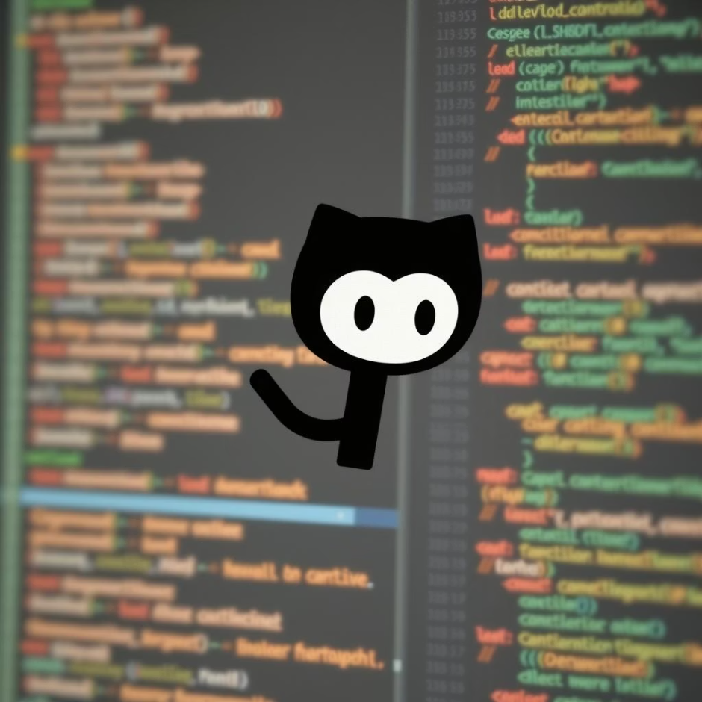

Connect with My Work
Explore the code, projects, and contributions on my official GitHub profile:
https://github.com/sheebaknownain
Thank You for Your Time and Attention!
Your interest in my digital portfolio is greatly appreciated. I look forward to the opportunity to discuss my projects and skills further.

